Slide 1
Miscellaneous compounds
Cisplatin
Mode of action→a potent inhibitor of DNA polymerase
↓
intrastrand cross linkage by the platinum complex

Slide 2
Uses: -
Cisplatin is used in combination with bleomycin and vinblastine for metastatic testicular tumors.
Used alone or in combination with doxorubicin for metastatic ovarian tumors, also penile cancer, bladder cancer, cervical cancer, head and neck cancer, and small cell cancer of the lung.

Slide 3
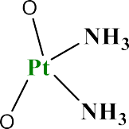
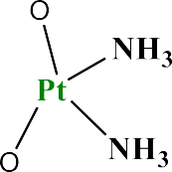
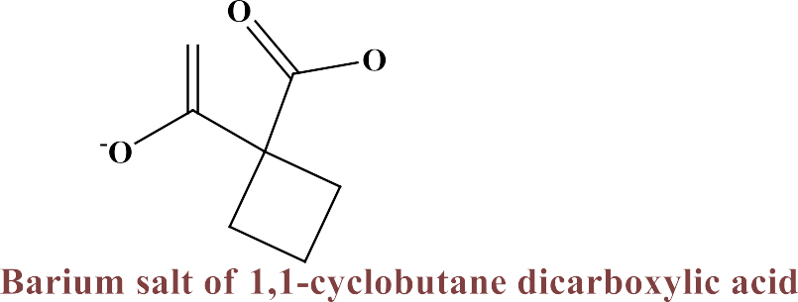
Carboplatin•
Uses: -treatment of ovarian cancer, non—small cell lung cancer, head and neck cancer, and testicular cancer.
Mode of action → resemble to cisplatine.

Slide 4
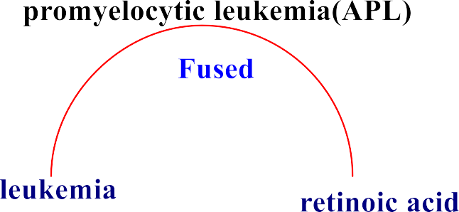
Arsenic trioxide(As₂O₃), trisenox:-
Uses and mechanism of action : -
stimulation of apoptosis →↓ activity and stimulation of caspase enzymes

Slide 5
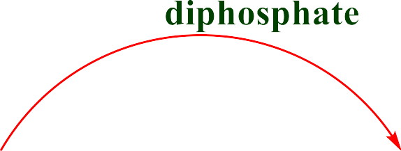
Hydroxyurea•
Mode of action
Uses: - Its active against melanoma, chronic myelocytic leukemia and metastatic ovarian carcinoma. Used in combination with radiotherapy for head and neck cancer.

Slide 6
Guanazole•
diaminotriazole
Mode of action
This diaminotriazole resembles hydroxyurea in its ability to limit DNA synthesis by inhibiting the reduction of rihonucleotides.
Uses: - It is clinically active in inducing
remissions of acute adult leukemia.

Slide 7
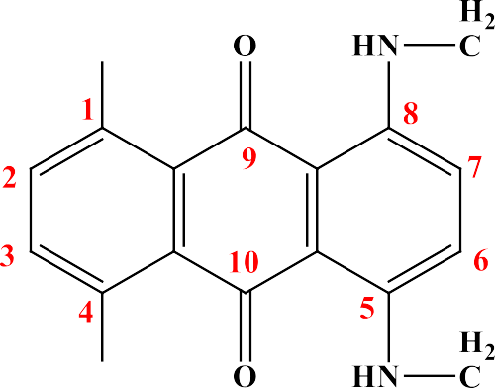
Mitoxatrone hydrochloride•

Slide 8
Hexamethylmelamine (Altretamine)•

Slide 9
Gallium Nitrate (Ganite) Ga(NO₃)₃.9H₂O Gallium nitrate is approved for treating cancer- related hypercalcemia. Gallium nitrate probably works in hypercalcemia by inhibiting calcium resorption from bone.

